Slide 1
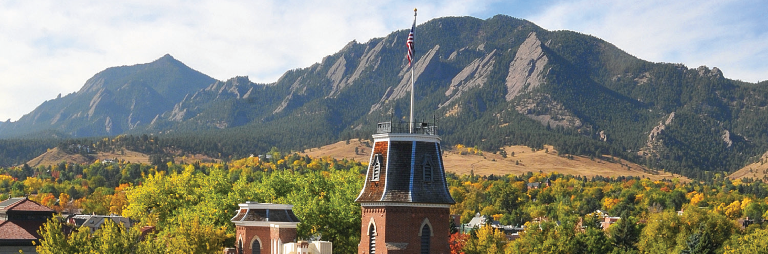
Installing containerized software on Alpine

Slide 2
Installing software on Alpine with Conda and Mamba
Date: February 27, 2024
Instructor: Andrew Monaghan
Contributors: Layla Freeborn, Trevor Hall, Brandon Reyes
Website: www.rc.colorado.edu
Documentation: https://curc.readthedocs.io
Helpdesk: rc-help@colorado.edu
Survey: http://tinyurl.com/curc-survey18

Slide 3

Slides
https://github.com/ResearchComputing/containerized_software_alpine_primer

Slide 4
Learning Objectives
What is a software container?
How can I find existing software containers?
How can I use a container on Alpine?
How can I build a container on Alpine?

Slide 5
Session Overview
Introduction
Installing software on CURC systems
Defining containers
Description of Apptainer
Setting up Conda on Alpine
Logging in
Using conda for the first time: creating the ~/.condarc file
Starting an interactive session and activating conda
Creating and Modifying Virtual Environments with Conda
Creating/activating/modifying a python environment
Useful conda commands and paths
Using Conda Virtual Environments
In HPC jobs
In OnDemand Jupyter
Strategies for installing complex Virtual Environments (Discussion only)
Channels
Resolving conflicts upon environment creation
Mamba

Slide 6
Building Software on Alpine
There are numerous ways to install software on Alpine:
grab pre-compiled binaries
compile from source
within virtual environments (via Conda, Miniconda, or Mamba)
using containers (Apptainer)
using a package manager for HPC systems (Spack)
Additional information:
https://github.com/ResearchComputing/research-software-curc

Slide 7
What is a Container?
A container is a portable environment that packages some or all of the following: an operating system, software, libraries, compilers, data, and workflows. Containers enable:
Mobility of compute
Reproducibility (software and data)
User Freedom

Slide 8


Containerization Software
Docker
Well-established
Most widely used
Millions of containers already available on DockerHub
Apptainer
Formerly “Singularity”
HPC-safe
Others

Slide 9
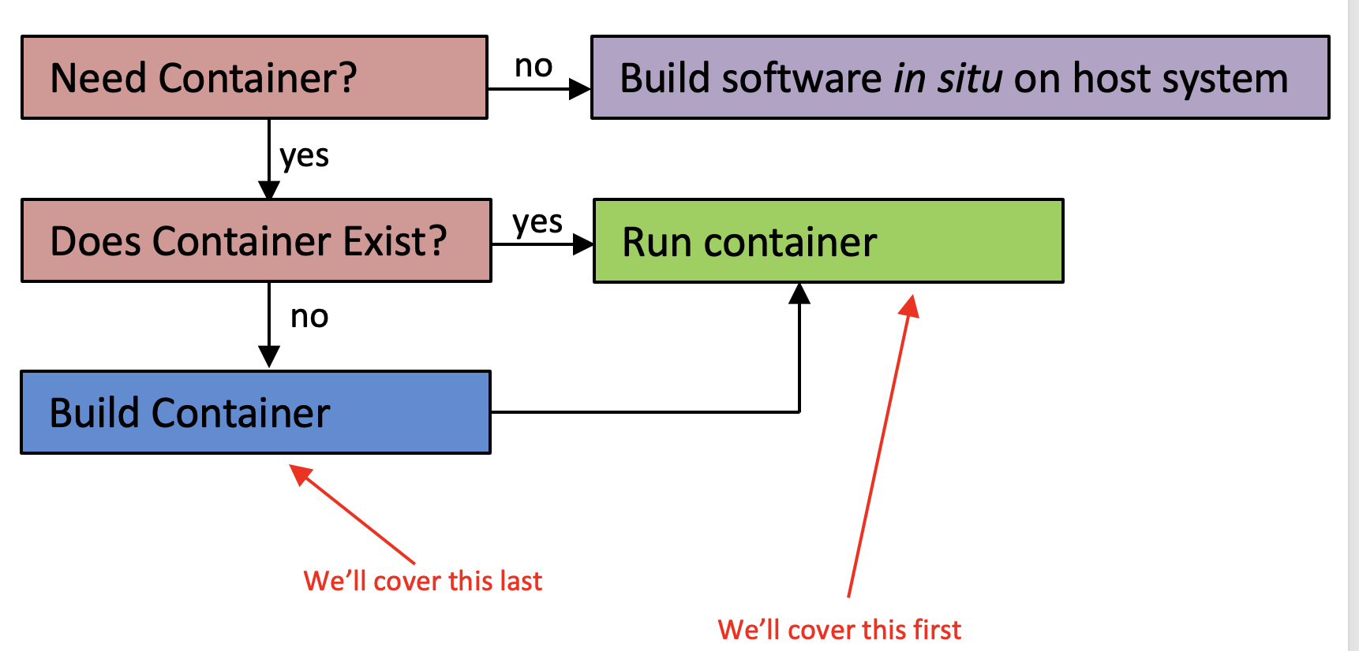
Making the decision to containerize

Slide 10
Logging into CU Research Computing
login to CURC via your terminal:
…or login to CURC via your browser:
https://ondemand-rmacc.rc.colorado.edu
(once logged in, navigate to Clusters -> Alpine shell)
ssh monaghaa@login.rc.colorado.edu
Additional information:
https://curc.readthedocs.io/en/latest/access/logging-in.html
https://curc.readthedocs.io/en/latest/gateways/OnDemand.html
Notes:
sinteractive --partition=atesting --qos=testing --time=90:00 --ntasks=1

Slide 11
Start a compute session
Start a session on an Alpine compute node with acompile:
Note: when you login to CURC you’ll be on a login node. You’ll need to be on a compute node to use apptainer. The acompile command allows you to quickly start an interactive job on a compute node.
[monaghaa@login11 ~]$ acompile --help
[monaghaa@login11 ~]$ acompile --ntasks=4 --time=90:00
…
[monaghaa@c3cpu-a5-u28-1 ~]$ apptainer --help
Additional information:
https://curc.readthedocs.io/en/latest/clusters/alpine/alpine-hardware.html#partitions
Notes:
sinteractive --partition=atesting --qos=testing --time=90:00 --ntasks=1

Slide 12
Let’s run our first container!
Invoke “R” statistical software in a pre-existing container:
Let’s run an external R script with the container
[monaghaa@c3cpu-a5-u28-1 ~]$ apptainer exec $CURC_CONTAINER_DIR/debian_r_4_2_2.sif R
> 1+2
> quit ()
[monaghaa@c3cpu-a5-u28-1 ~]$ ls $CURC_CONTAINER_DIR/ # ← what the heck is in this directory?
[monaghaa@c3cpu-a5-u28-1 ~]$ cd /scratch/alpine/$USER
[monaghaa@c3cpu-a5-u28-1 ~]$ git clone https://github.com/ResearchComputing/containerized_software_alpine_primer
[monaghaa@c3cpu-a5-u28-1 ~]$ cd containerized_software_alpine_primer/examples
[monaghaa@c3cpu-a5-u28-1 ~]$ apptainer exec $CURC_CONTAINER_DIR/debian_r_4_2_2.sif Rscript prime_functions.R
Notes:
sinteractive --partition=atesting --qos=testing --time=90:00 --ntasks=1

Slide 13
Key Apptainer Commands
exec: Execute a command to your container
run: Run your image as an executable (behavior must be predefined)
build: Build a container on your user endpoint or build environment
pull: pull an image from Docker or Singularity Hub
inspect: See labels, run and test scripts, and environment variables
shell: Shell into your image
Notes:
sinteractive --partition=atesting --qos=testing --time=90:00 --ntasks=1

Slide 14
Now let’s explore a container
Shell into the container:
Inspect how the container was built:
…now let’s look more closely at a container definition file
[monaghaa@c3cpu-a5-u28-1 ~]$ apptainer shell $CURC_CONTAINER_DIR/gmtsar_v6.2.sif
Apptainer> cat /etc/os-release # what operating system is in the container?
Apptainer> ls /usr/local # what do you see?
Apptainer> exit
[monaghaa@c3cpu-a5-u28-1 ~]$ apptainer inspect -d $CURC_CONTAINER_DIR/gmtsar_v6.2.sif
Notes:
sinteractive --partition=atesting --qos=testing --time=90:00 --ntasks=1

Slide 15
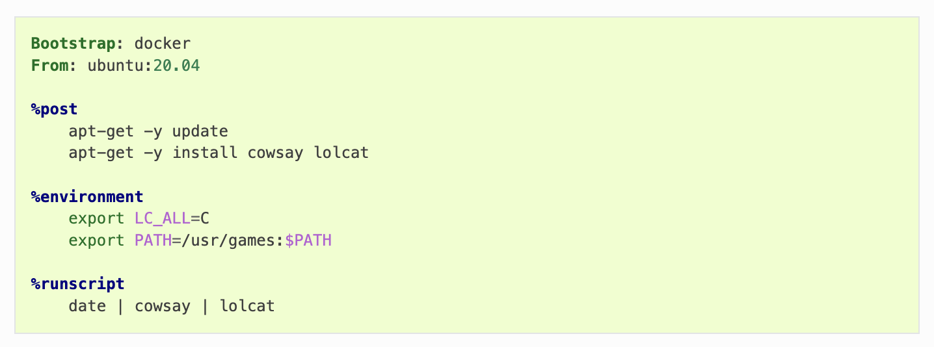
Container definition file
lolcow.def
Example source: https://apptainer.org/docs/user/latest/definition_files.html
Notes:
Demo:
-which python
-show how conda environment is organized
-start python
-import pandas (show error)

Slide 16
Now let’s build and run a container
[monaghaa@c3cpu-a5-u28-1 ~]$ apptainer build lolcow.sif lolcow.def
…will take a couple of minutes
# run default container behavior
[monaghaa@c3cpu-a5-u28-1 ~]$ apptainer run lolcow.sif
# run your own script from container
[monaghaa@c3cpu-a5-u28-1 ~]$ apptainer exec lolcow.sif /bin/sh lolcow.sh
Notes:
sinteractive --partition=atesting --qos=testing --time=90:00 --ntasks=1

Slide 17
Now let’s pull and run a Docker container
[monaghaa@c3cpu-a5-u28-1 ~]$ apptainer pull cp2k.sif docker://cp2k/cp2k:latest
…will take a couple of minutes
# run at command line:
[monaghaa@c3cpu-a5-u28-1 ~]$ apptainer run cp2k.sif cp2k -o md300.out md300.inp
# schedule a job
[monaghaa@c3cpu-a5-u28-1 ~]$ sbatch run_cp2k.sh
Notes:
sinteractive --partition=atesting --qos=testing --time=90:00 --ntasks=1

Slide 18
More complex topics (if time allows)
Bind mounting external directories
Using containers on GPUs
Using containers with MPI

Slide 19

Thank you!
http://tinyurl.com/curc-survey18
Survey and feedback

